Slide 1
Microsoft Power BI

Slide 2
Modern React-JS Development with App-Owns-Data Embedding
Ted Pattison
Principal Program Manager
Power BI Customer Advisory Team (PBICAT)

Slide 3
Developer Sample used in This Session
App-Owns-Data Starter Kit
Sample App-Owns-Data Starter Project with SPA Architecture
Frontend Client SPA Developed using React, TypeScript, MSAL and Power BI REST API
Backend Web API developed using ASP.NET 6.0

Slide 4
Agenda
Quick Review of Modern React
App-Owns-Data Application Architecture
Designing a View Model for a Multitenant Application
Designing a Functional Component for Embedding Reports
Managing Embed Token Expiration
Providing Users with Export-to-File Commands
Designing a Self-service Authoring Experience

Slide 5
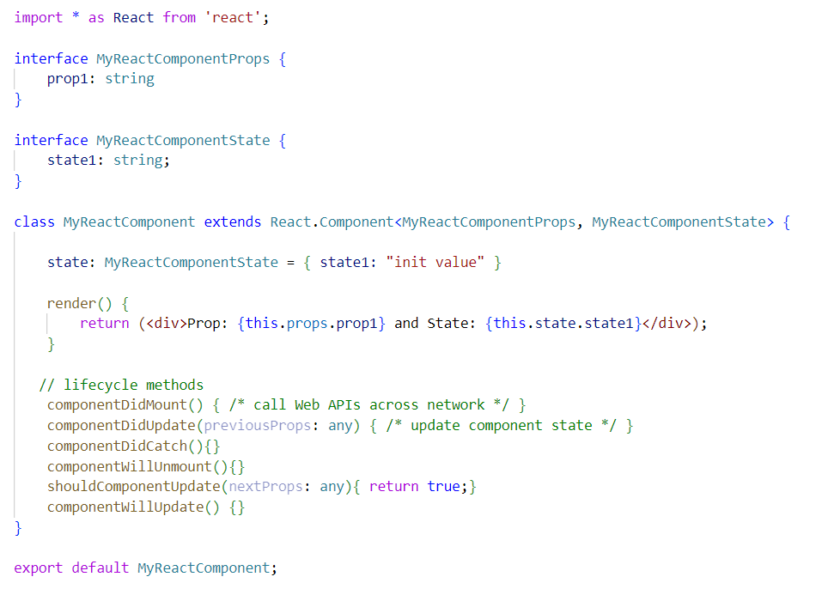
Migrating from Classic React to Modern React
Classic React based on class-based components and lifecycle method
Modern React based on functional components and hooks
Class React with Class-based Components
Modern React with Functional Components

Slide 6
Hooks – a few quick examples
Hooks provided by React demonstrated in this session
useState
useEffect
useLayoutEffect
useRef
useNavigate
useContext
Hooks provided by Microsoft Authentication Library for React
useIsAuthenticated
useMsal
useAccount

Slide 7
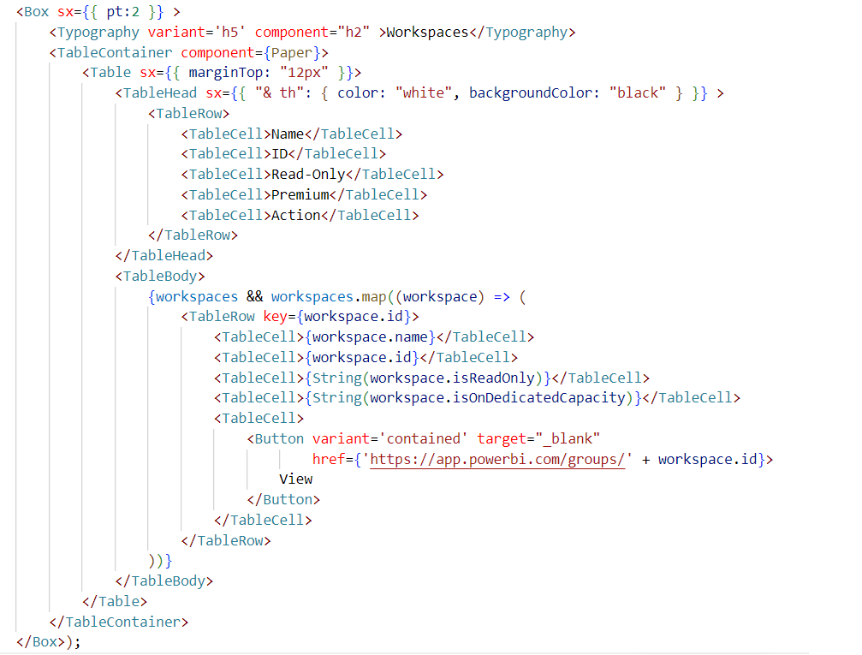
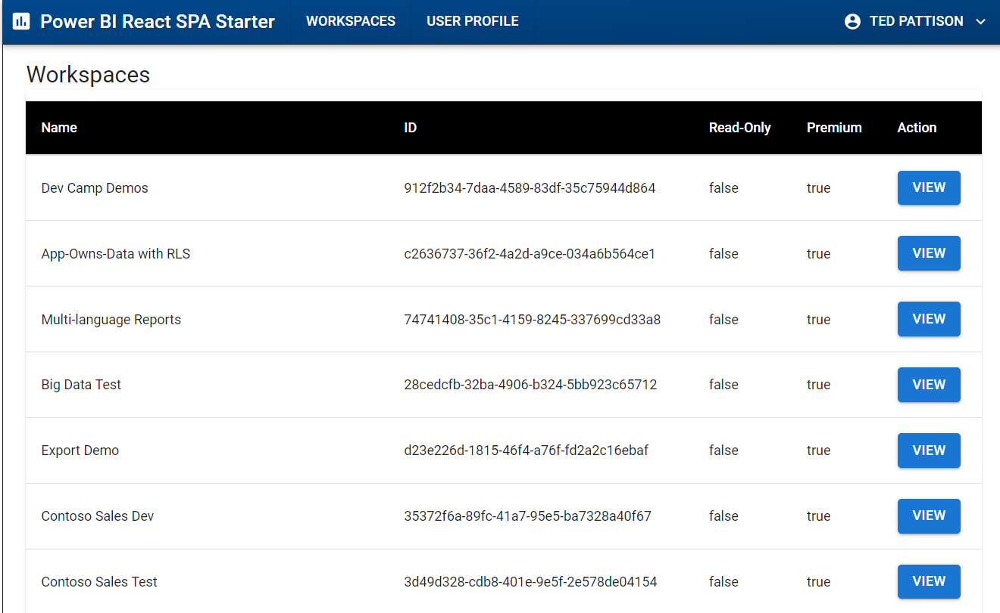
Working with React Components from Material UI
Import Material UI Components
Build UI using Material UI components

Slide 8
MSAL.js V 2.0
Microsoft Authentication Library for JavaScript
Authenticates SPA users with Azure AD
Install using node.js - npm i @azure/msal-browser
Docs: https://github.com/AzureAD/microsoft-authentication-library-for-js

Slide 9
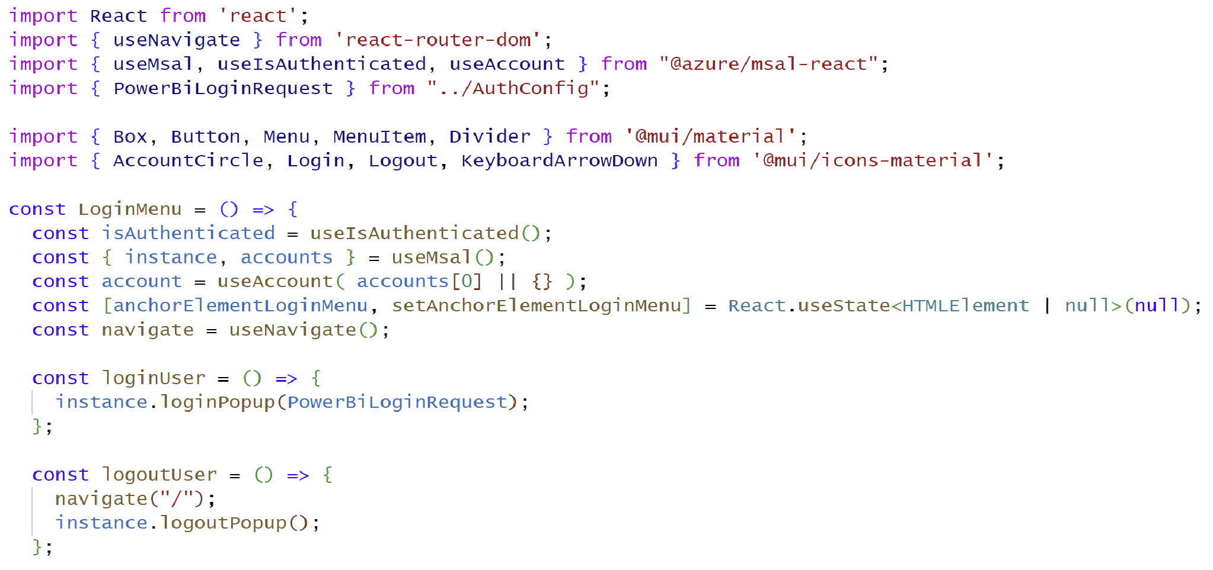
MSAL Component for React (@azure/msal-react)
msal-react designed with hooks
useMsal
useIsAuthenticated
useAccount

Slide 10
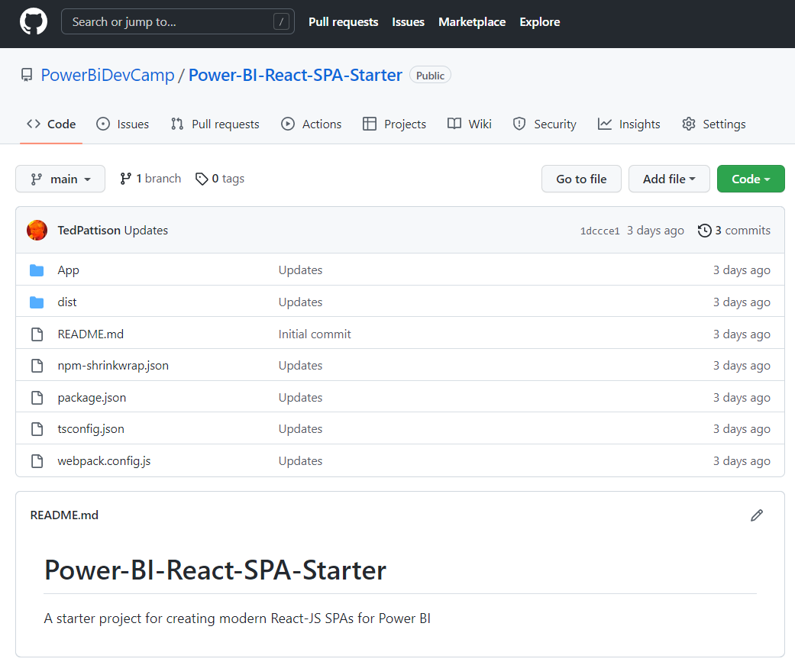
GitHub Repository: Power-BI-React-SPA-Starter
Demo code from this session available in public GitHub repository
https://github.com/PowerBiDevCamp/Power-BI-React-SPA-Starter

Slide 11
Agenda
Quick Review of Modern React
App-Owns-Data Application Architecture
Designing a View Model for a Multitenant Application
Designing a Functional Component for Embedding Reports
Managing Embed Token Expiration
Providing Users with Export-to-File Commands
Designing a Self-service Authoring Experience

Slide 12
App-Owns-Data Starter Kit Architecture
AppOwnsDataDB: custom database to track tenants, user permissions and user activity
AppOwnsDataAdmin: administrative app to create tenants and manage user permissions
AppOwnsDataWebApi: custom Web API used by client-side SPA applications
AppOwnsDataClient: customer-facing SPA used to view and author reports (JavaScript & JQuery)
AppOwnsDataReactClient : customer-facing SPA used to view and author reports (modern React-JS)
AppOwnsDataAdmin
AppOwnsDataDB
Power BI REST API
AppOwnsDataClient
AppOwnsDataWebApi
AppOwnsDataReactClient

Slide 13
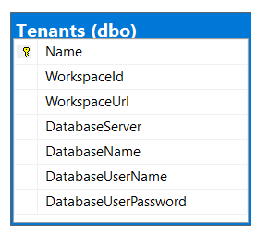
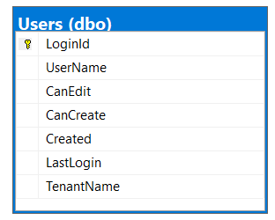
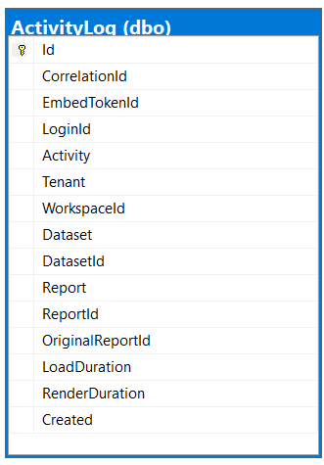
Database Schema for AppOwnsDataDB
Tenants table tracks Power BI workspace Id and customer database connection info
Users table tracks user profile with tenant assignment and permissions within tenant
ActivityLog table tracks telemetry data about user activity and report performance

Slide 14
AppOwnsDataWebApi
Provides service-oriented architecture endpoints for AppOwnsDataClient
Provides endpoint to process user login
Provides endpoint to retrieve embedding data and embed tokens
Provides endpoint to log activity events to be recorded in AppOwnsDataDB
AppOwnsDataReactClient
AppOwnsDataWebApi
Power BI REST API
Azure AD Client App
Azure AD Service App
AppOwnsDataDB

Slide 15
AppOwnsDataWebApi Controllers
UserLogin
Called by client SPA once after user authenticates
Embed
Called to retrieve embedding data for a specific tenant
EmbedToken
Called to retrieve new embed token
ActivityLog
Called to post activity event to custom audit log
ExportToFile
Called in response to user action to export report to file

Slide 16
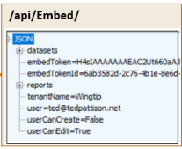
Embedding Data View Model
AppOwnsDataWebApi returns view model to AppOwnsDataClient
View model contains embedding data for reports and datasets
View model contains embed token used to embed reports
Embed tokens contains set of permissions generated for current user
AppOwnsDataClient
AppOwnsDataWebApi

Slide 17
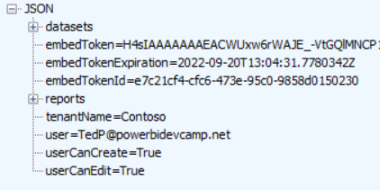
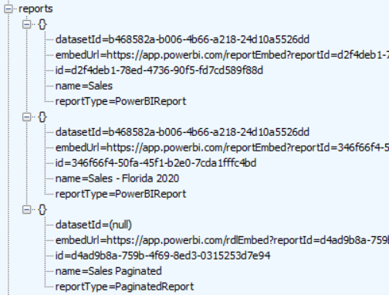
EmbedController

Slide 18
Agenda
Quick Review of Modern React
App-Owns-Data Application Architecture
Designing a View Model for a Multitenant Application
Designing a Functional Component for Embedding Reports
Managing Embed Token Expiration
Providing Users with Export-to-File Commands
Designing a Self-service Authoring Experience

Slide 19
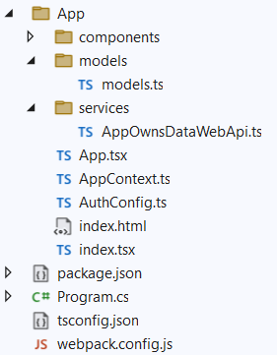
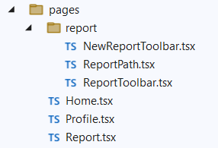

Slide 20
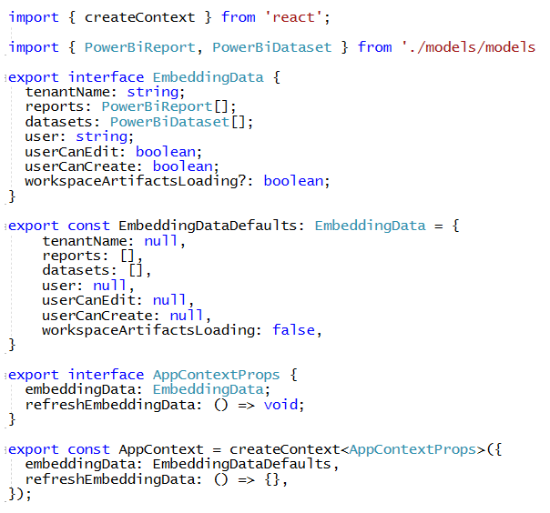
AppContext.ts

Slide 21
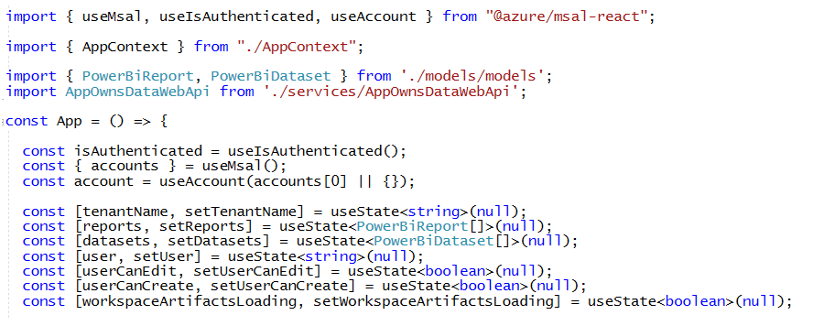
App.tsx

Slide 22
useEffect in App.tsx

Slide 23
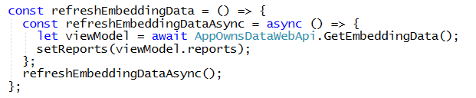
refreshEmbeddingData in App.tsx

Slide 24
ss

Slide 25
Agenda
Quick Review of Modern React
App-Owns-Data Application Architecture
Designing a View Model for a Multitenant Application
Designing a Functional Component for Embedding Reports
Managing Embed Token Expiration
Providing Users with Export-to-File Commands
Designing a Self-service Authoring Experience

Slide 26
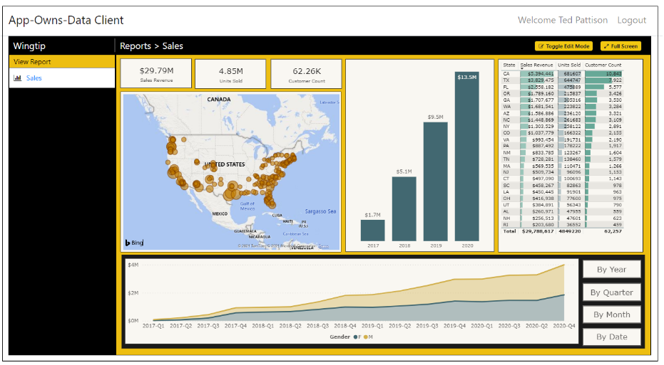
AppOwnsDataClient
Built as simple Single Page Application (SPA)
Client authenticates user and acquires access tokens to call AppOwnsDataWebApi
Project configured with node.js and webpack to support Typescript compilation
Project includes node.js packages for jQuery and Power BI JavaScript API
Project easily extended to support development with React or Angular
AppOwnsDataClient
Azure AD
Client App
AppOwnsDataWebApi

Slide 27
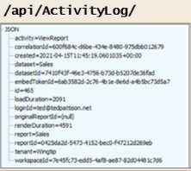
Adding a custom telemetry layer
App-Owns-Data Starter Kit demonstrates adding custom telemetry
AppOwnsDataWebApi exposes ActivityLog endpoint
AppOwnsDataClient logs custom events by posting to ActivityLog endpoint
AppOwnsDataWebApi records event activity in AppOwnsDataDB
AppOwnsDataClient
AppOwnsDataWebApi
AppOwnsDataDB

Slide 30
Embedding Data View Model
AppOwnsDataWebApi returns view model to AppOwnsDataClient
View model contains embedding data for reports and datasets
View model contains embed token used to embed reports
Embed tokens contains set of permissions generated for current user
AppOwnsDataClient
AppOwnsDataWebApi

Slide 32
Agenda
Quick Review of Modern React
App-Owns-Data Application Architecture
Designing a View Model for a Multitenant Application
Designing a Functional Component for Embedding Reports
Managing Embed Token Expiration
Providing Users with Export-to-File Commands
Designing a Self-service Authoring Experience

Slide 34
Agenda
Quick Review of Modern React
App-Owns-Data Application Architecture
Designing a View Model for a Multitenant Application
Designing a Functional Component for Embedding Reports
Managing Embed Token Expiration
Providing Users with Export-to-File Commands
Designing a Self-service Authoring Experience

Slide 36
Agenda
Quick Review of Modern React
App-Owns-Data Application Architecture
Designing a View Model for a Multitenant Application
Designing a Functional Component for Embedding Reports
Managing Embed Token Expiration
Providing Users with Export-to-File Commands
Designing a Self-service Authoring Experience

Slide 37
Exporting Power BI Reports
ExportReportRequest contains PowerBIReportExportConfiguration property
Controls whether to include hidden pages
Allows caller to apply filtering during export process
Allows caller to apply a bookmark or bookmark state during export process
Allows caller control to embed entire report, a single page or a single visual
Export configuration data passed to ExportToFileInGroup API as JSON in request body

Slide 38
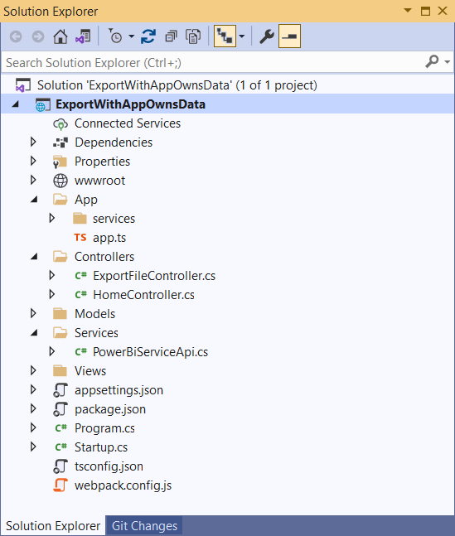
Developer Sample - ExportWithAppOwnsData
Sample application demonstrates exporting reports with App-Owns-Data
All Power BI REST API calls executed as service principal
Solution architecture requires client call from browser to custom Web API
Custom Web API calls Power BI Export API and returns file back to browser

Slide 39
Capturing Bookmark State and Active Page Name
Custom bookmarks can be capture using Power BI JavaScript API
Bookmark can be captured dynamically using bookmarkManager.capture()
Captured bookmark hold current filter settings applied by user
Custom bookmark state can be used to retain filter setting during export job

Slide 40
App-Owns-Data Export Sample Architecture
JavaScript Code
running in Browser
C# code running in
Custom Web API
Power BI REST API
ExportFile – Custom Web API
synchronous
blocking call
ExportToFileInGroup
asynchronous
non blocking call
GetExportToFileStatusInGroup
Exported
File
Exported
File
Exported
File
ExportFile API Response
GetFileOfExportToFileInGroup

Slide 41
Exporting a Single Page using Bookmark State
Custom bookmarks make it possible to retain current slicer settings
Allows for submitting exporting job with same filtering in current report or page
JavaScript
running in Browser
Custom Web API
Power BI REST API

Slide 42
App-Owns-Data Embedding with Paginated Reports
Embedded paginated reports display Export menu
User can use Export menu to download export by hand in any available format
No need to include custom web API as with exporting Power BI report with App-Owns-Data

Slide 44
Agenda
Quick Review of Modern React
App-Owns-Data Application Architecture
Designing a View Model for a Multitenant Application
Designing a Functional Component for Embedding Reports
Managing Embed Token Expiration
Providing Users with Export-to-File Commands
Designing a Self-service Authoring Experience

Slide 45
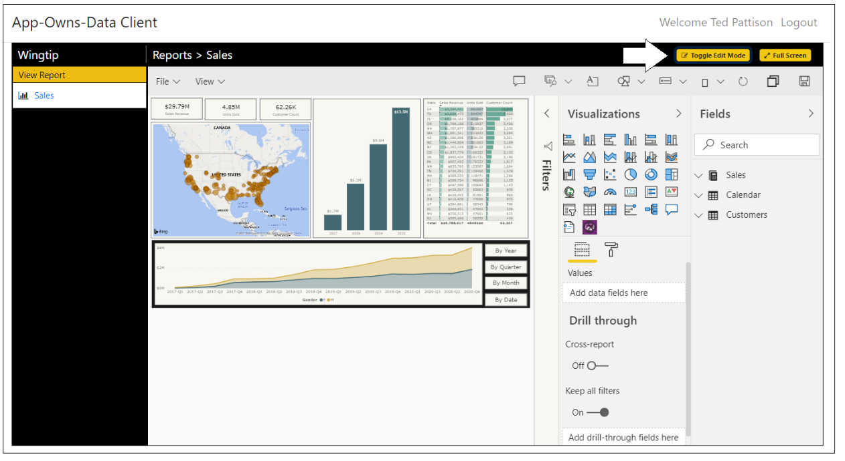
Report Authoring
AppOwnsDataClient demonstrates report authoring features
Users with edit permissions can move report into edit view and customize layout
Users with create permissions can copy existing reports and create new reports

Slide 46
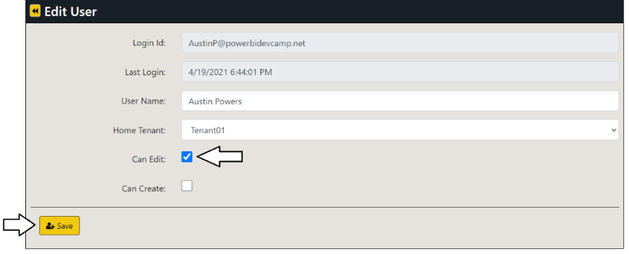
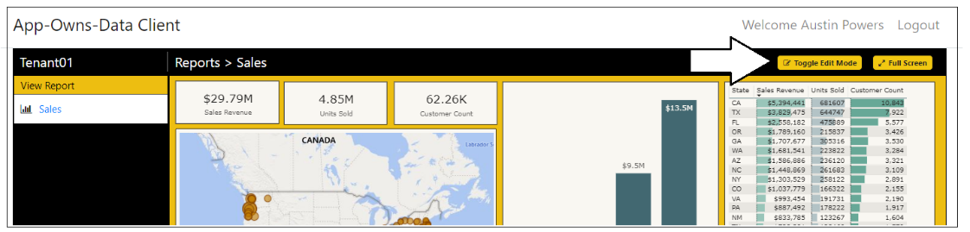
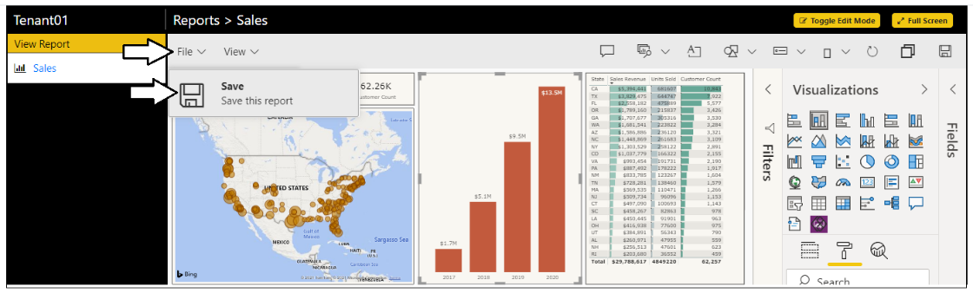
Edit reports using AppOwnsDataClient
Test user experience when user has edit permissions
User can move report into edit mode
Once in edit mode, you can customize report and save changes

Slide 47
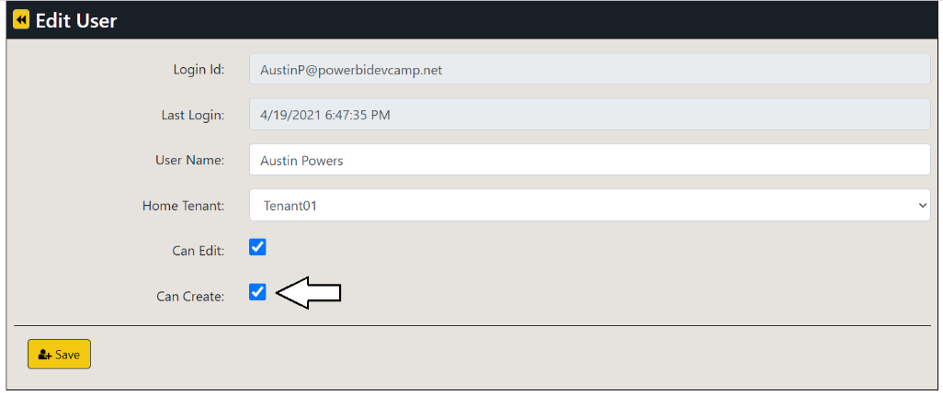
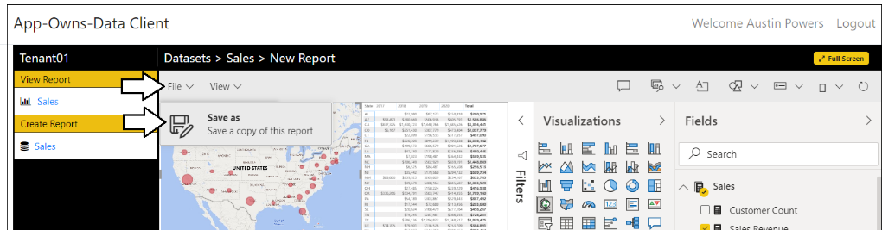
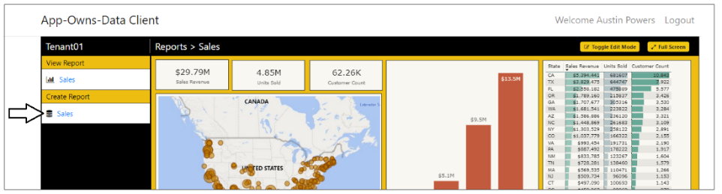
Create New Content using AppOwnsDataClient
Test user experience when user has edit + create permissions
User can use Save As command on report in edit mode to copy a report
User can click dataset link in Create Report section to create new report

Slide 49
Summary
Quick Review of Modern React
App-Owns-Data Application Architecture
Designing a View Model for a Multitenant Application
Designing a Functional Component for Embedding Reports
Managing Embed Token Expiration
Providing Users with Export-to-File Commands
Designing a Self-service Authoring Experience

Slide 50
Call to Action
Download and try out the samples
https://github.com/PowerBiDevCamp/Power-BI-React-SPA-Starter
https://github.com/PowerBiDevCamp/Modern-React-For-PowerBI
Learn more about modern React
https://beta.reactjs.org
Join Power BI Dev Camp Next Month for More React Coverage
Next month’s session covers modern REACT-JS development with App-Owns-Data embedding
https://aka.ms/devcamplive
Live and Love the Power BI Community
https://community.powerbi.com/

Slide 51
Microsoft Power BI
Questions?

